Slide 1


CIS300 Test Review
Dale McIntosh
Fall 2009
© 2009 Dale McIntosh. All Rights Reserved.

Slide 2
CIS300 Test 2 – All others
Mathematical Functions
ROUND
SUMIF
Statistical Functions
AVERAGEIF
COUNTIF
LARGE
SMALL
Lookup Functions
HLOOKUP
LOOKUP
VLOOKUP
Information Functions
ISERROR
ISNA
ISREF

Slide 3
Microsoft® Excel® Mathematical Functions
ROUND
=ROUND(number,num_digits)
SUMIF
=SUMIF(range,criteria,[sum_range])

Slide 4
The ROUND function
Syntax:
=ROUND(number, num_digits)
Arguments:
number Required
The number that you want to round.
num_digits Required
The number of digits to which you want to round the number argument.

Slide 5
The ROUND function
Description:
Rounds a number to a specified number of digits.
Remarks:
If num_digits is greater than 0 (zero), then number is rounded to the specified number of decimal places.
If num_digits is 0, the number is rounded to the nearest integer.
If num_digits is less than 0, the number is rounded to the left of the decimal point.
Errors:
None

Slide 6
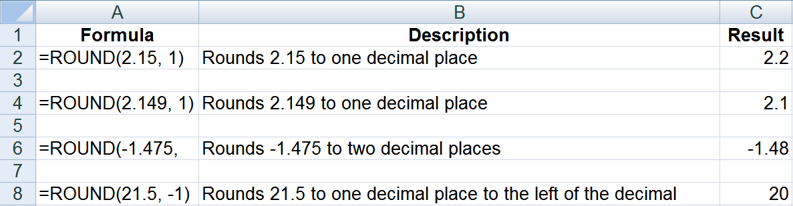
The ROUND function
=ROUND(-1.475,2) Rounds -1.475 to two decimal places

Slide 7
Textbook Question
To a great extent, the operating system determines which applications a computer can run.
TRUE
FALSE

Slide 8
Textbook Question
To a great extent, the operating system determines which applications a computer can run.
TRUE ✓
FALSE
Ref: p.61

Slide 9
The SUMIF function
Syntax:
=SUMIF(range, criteria, [sum_range])
Arguments:
range Required
The range of cells that you want evaluated by criteria.
Cells in each range must be numbers or names, arrays, or references that contain numbers.
Blank and text values are ignored.
criteria Required
The criteria in the form of a number, expression, a cell reference, text, or a function that defines which cells will be added.
Criteria can be expressed as 32, ">32", B5, "32", "apples", or TODAY().
sum_range Optional
The actual cells to add, if you want to add cells other than those specified in the range argument.
Excel adds the cells that are specified in the range argument (the same cells to which the criteria is applied).

Slide 10
The SUMIF function
Description:
Sums the values in a range that meet criteria that you specify.
Remarks:
See the Microsoft® Excel® help for additional remarks.
Errors:
None

Slide 11
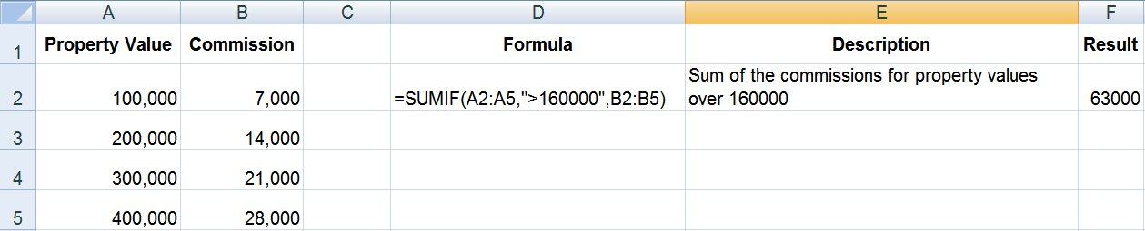
The SUMIF function

Slide 12
Textbook Question
Adding to a product or service to increase its value to the consumer is called ____.
adding value
enhancing existing products or services
increasing value
incrementing service

Slide 13
Textbook Question
Adding to a product or service to increase its value to the consumer is called ____.
adding value
enhancing existing products or services ✓
increasing value
incrementing service
Ref. pp. 49-50

Slide 14
Microsoft® Excel® Statistical Functions
COUNTIF
=COUNTIF(range, criteria)
LARGE
=LARGE(array,k)
SMALL
=SMALL(array,k)

Slide 15
The COUNTIF function
Syntax:
=COUNTIF(range, criteria)
Arguments:
range Required
One or more cells to count, including numbers or names, arrays, or references that contain numbers.
Blank and text values are ignored.
criteria Required
A number, expression, cell reference, or text string that defines which cells will be counted.
Criteria can be expressed as 32, ">32", B4, "apples", or "32".

Slide 16
The COUNTIF function
Description:
Counts the number of cells within a range that meet a single criterion that you specify.
Remarks:
See the Microsoft® Excel® help for additional remarks.
Criteria are case insensitive
Errors:
None

Slide 17
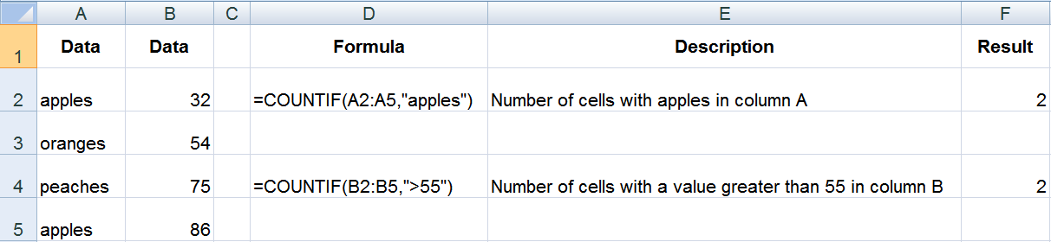
The COUNTIF function

Slide 18
Textbook Question
Implementation of a(n) ____ requires a business to revamp processes—to undergo organizational change—to gain an advantage.
BI
CRM
GIS
SIS

Slide 19
Textbook Question
Implementation of a(n) ____ requires a business to revamp processes—to undergo organizational change—to gain an advantage.
BI
CRM
GIS
SIS ✓
Ref: p. 56

Slide 20
Creating and Maintaining Strategic Information Systems
Many opportunities to accomplish competitive edge with information technology
Innovative software can establish a competitive advantage
Strategic information systems can be created from scratch or by modifying a previous system
To be an SIS, an information system must:
Serve an organization goal
Collaborate with other functional units of company

Slide 21
The LARGE function
Syntax:
=LARGE(array,k)
Arguments:
array Required
The array or range of data for which you want to determine the k-th largest value.
k Required
The position (from the largest) in the array or cell range of data to return.

Slide 22
The LARGE function
Description:
Returns the k-th largest value in a data set.
Remarks:
If n is the number of data points in a range, then LARGE(array,1) returns the largest value.
If n is the number of data points in a range, then LARGE(array,n) returns the smallest value.
Errors:
#NUM! – If array is empty
#NUM! – If k ≤ 0
#NUM! – If k is greater than the number of data points

Slide 23
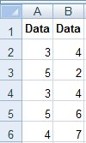
3rd largest number in the numbers in columns A and B
=LARGE(array,k)

Slide 24
3rd largest number in the numbers in columns A and B
=LARGE(array,k)
=LARGE(A2:B6

Slide 25
3rd largest number in the numbers in columns A and B
=LARGE(array,k)
=LARGE(A2:B6,3)

Slide 26
3rd largest number in the numbers in columns A and B
List the numbers in descending order:
7
6
5
5
4
4
4
3
3
2
=LARGE(array,k)
=LARGE(A2:B6,3)
=5

Slide 27
7th largest number in the numbers in columns A and B
=LARGE(array,k)

Slide 28
7th largest number in the numbers in columns A and B
=LARGE(array,k)
=LARGE(A2:B6

Slide 29
7th largest number in the numbers in columns A and B
=LARGE(array,k)
=LARGE(A2:B6,7)

Slide 30
7th largest number in the numbers in columns A and B
List the numbers in descending order:
7
6
5
5
4
4
4
3
3
2
=LARGE(array,k)
=LARGE(A2:B6,7)

Slide 31
7th largest number in the numbers in columns A and B
List the numbers in descending order:
7
6
5
5
4
4
4
3
3
2
=LARGE(array,k)
=LARGE(A2:B6,7)
=4

Slide 32
Textbook Question
A company achieves ____________________ by using strategy to maximize its strengths, resulting in a competitive advantage.

Slide 33
Textbook Question
A company achieves strategic advantage by using strategy to maximize its strengths, resulting in a competitive advantage.
Ref. p. 42

Slide 34
The SMALL function
Syntax:
=SMALL(array,k)
Arguments:
array Required
The array or range of data for which you want to determine the k-th smallest value.
k Required
The position (from the smallest) in the array or cell range of data to return.

Slide 35
The SMALL function
Description:
Returns the k-th smallest value in a data set.
Remarks:
If n is the number of data points in a range, then SMALL(array,1) returns the smallest value.
If n is the number of data points in a range, then SMALL(array,n) returns the largest value.
Errors:
#NUM! – If array is empty
#NUM! – If k ≤ 0
#NUM! – If k is greater than the number of data points

Slide 36
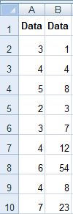
4th smallest number in first column
=SMALL(array,k)

Slide 37
4th smallest number in first column
=SMALL(array,k)
=SMALL(A2:A10

Slide 38
4th smallest number in first column
List the numbers in ascending order:
2
3
3
4
4
4
5
6
7
=SMALL(array,k)
=SMALL(A2:A10,4)

Slide 39
4th smallest number in first column
List the numbers in ascending order:
2
3
3
4
4
4
5
6
7
=SMALL(array,k)
=SMALL(A2:A10,4)
=4

Slide 40
2nd smallest number in second column
=SMALL(array,k)

Slide 41
2nd smallest number in second column
=SMALL(array,k)
=SMALL(B2:B10

Slide 42
2nd smallest number in second column
List the numbers in ascending order:
1
3
4
7
8
8
12
23
54
=SMALL(array,k)
=SMALL(B2:B10,2)

Slide 43
2nd smallest number in second column
List the numbers in ascending order:
1
3
4
7
8
8
12
23
54
=SMALL(array,k)
=SMALL(B2:B10,2)
=3

Slide 44
Textbook Question
When the process of marketing products is complete, the next link in the supply chain is shipping.
TRUE
FALSE

Slide 45
Textbook Question
When the process of marketing products is complete, the next link in the supply chain is shipping.
TRUE
FALSE ✓

Slide 46
Supply Chain Management
Supply chain: consists of procurement of raw materials, processing materials into goods, and delivering goods
Processing raw materials into goods is also known as manufacturing
Supply chain management: monitoring, controlling, and facilitating supply chains
CAD systems often transfer data automatically to CAM systems

Slide 47
Microsoft® Excel® Lookup Functions
VLOOKUP
=VLOOKUP(lookup_value, table_array, col_index_num, [range_lookup])

Slide 48
The VLOOKUP function
Syntax:
=VLOOKUP(lookup_value,table_array,col_index_num,[range_lookup])
Arguments:
lookup_value Required
The value to search in the first column of the table or range.
table_array Required
The range of cells that contains the data.
col_index_num Required
The column number in the table_array argument from which the matching value must be returned.
range_lookup Optional
A logical value that specifies whether you want VLOOKUP to find an exact match or an approximate match.

Slide 49
The VLOOKUP function
Description:
Searches the first column of a range of cells, and then returns a value from any cell on the same row of the range.
Remarks:
The values in the first column of table_array can be text, numbers, or logical values.
Uppercase and lowercase text are equivalent.
If range_lookup is TRUE, the values in the first column of table_array must be placed in ascending order.
If range_lookup is TRUE or omitted, an approximate match is returned.
If range_lookup is FALSE, an exact match will be attempted.

Slide 50
The VLOOKUP function
Errors:
#VALUE! – If col_index_num is less than 1
#REF! – If col_index_num is greater than the number of columns in the table_array
#N/A – If range_lookup is FALSE and an exact match cannot be found
#N/A – If lookup_value is less than the smallest value in the first column of table_array

Slide 51
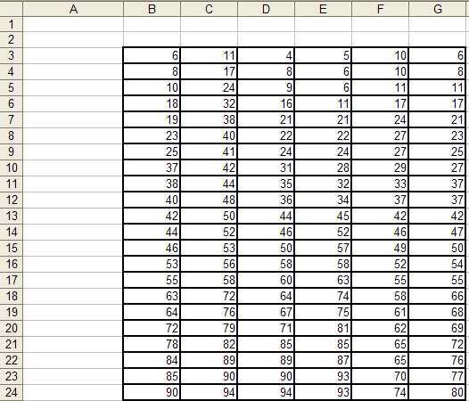
=VLOOKUP(C11*2, $B$8:$G$24, G18/E6, TRUE)
=VLOOKUP(IF(MIN(B6:F18)<>MAX(D3:G5), 38, 83), E11:G22,3)
=VLOOKUP(MAX(B3:G4)*B6/G3, $C$8:$F$20, 3, FALSE)
=VLOOKUP(C3*E3, C8:F20, IF(SUM(B3:B24)>SUM(F3:F24), 2, 4))
=VLOOKUP(LARGE(D10:G17,4), $C$8:$F$20, 5, FALSE)

Slide 52
=VLOOKUP(C11*2, $B$8:$G$24, G18/E6, TRUE)

Slide 53
=VLOOKUP(C11*2, $B$8:$G$24, G18/E6, TRUE)
=VLOOKUP(44*2, $B$8:$G$24, G18/E6, TRUE)

Slide 54
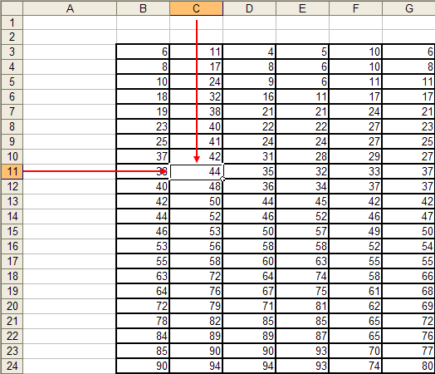
=VLOOKUP(C11*2, $B$8:$G$24, G18/E6, TRUE)
=VLOOKUP(44*2, $B$8:$G$24, G18/E6, TRUE)
=VLOOKUP(88, $B$8:$G$24, G18/E6, TRUE)

Slide 55
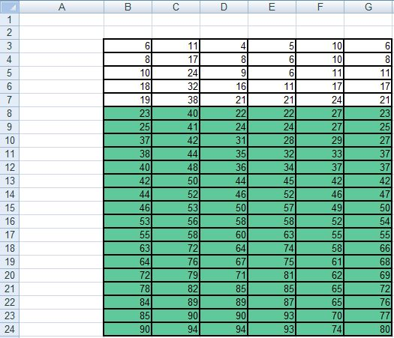
=VLOOKUP(C11*2, $B$8:$G$24, G18/E6, TRUE)
=VLOOKUP(44*2, $B$8:$G$24, G18/E6, TRUE)
=VLOOKUP(88, $B$8:$G$24, G18/E6, TRUE)

Slide 56
=VLOOKUP(C11*2, $B$8:$G$24, G18/E6, TRUE)
=VLOOKUP(44*2, $B$8:$G$24, G18/E6, TRUE)
=VLOOKUP(88, $B$8:$G$24, G18/E6, TRUE)
=VLOOKUP(88, $B$8:$G$24, 66/E6, TRUE)

Slide 57
=VLOOKUP(C11*2, $B$8:$G$24, G18/E6, TRUE)
=VLOOKUP(44*2, $B$8:$G$24, G18/E6, TRUE)
=VLOOKUP(88, $B$8:$G$24, G18/E6, TRUE)
=VLOOKUP(88, $B$8:$G$24, 66/E6, TRUE)
=VLOOKUP(88, $B$8:$G$24, 66/11, TRUE)

Slide 58
=VLOOKUP(C11*2, $B$8:$G$24, G18/E6, TRUE)
=VLOOKUP(44*2, $B$8:$G$24, G18/E6, TRUE)
=VLOOKUP(88, $B$8:$G$24, G18/E6, TRUE)
=VLOOKUP(88, $B$8:$G$24, 66/E6, TRUE)
=VLOOKUP(88, $B$8:$G$24, 66/11, TRUE)
=VLOOKUP(88, $B$8:$G$24, 6, TRUE)

Slide 59
(2) =VLOOKUP(IF(MIN(B6:F18)<>MAX(D3:G5), 38, 83), E11:G22,3)

Slide 60
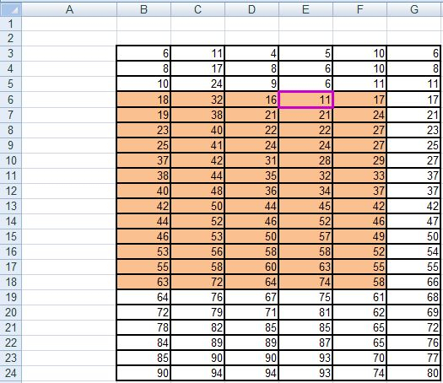
=VLOOKUP(IF(MIN(B6:F18)<>MAX(D3:G5), 38, 83), E11:G22,3)
=VLOOKUP(IF(11<>MAX(D3:G5), 38, 83), E11:G22,3)

Slide 61
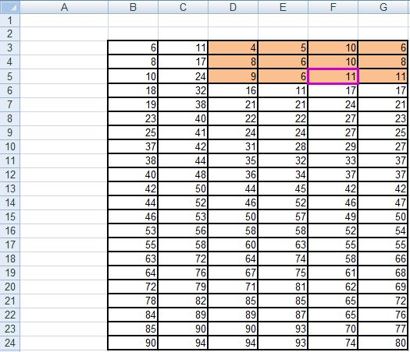
=VLOOKUP(IF(MIN(B6:F18)<>MAX(D3:G5), 38, 83), E11:G22,3)
=VLOOKUP(IF(11<>MAX(D3:G5), 38, 83), E11:G22,3)
=VLOOKUP(IF(11<>11, 38, 83), E11:G22,3)

Slide 62
=VLOOKUP(IF(MIN(B6:F18)<>MAX(D3:G5), 38, 83), E11:G22,3)
=VLOOKUP(IF(11<>MAX(D3:G5), 38, 83), E11:G22,3)
=VLOOKUP(IF(11<>11), 38, 83), E11:G22,3)
=VLOOKUP(IF(FALSE, 38, 83), E11:G22,3)

Slide 63
=VLOOKUP(IF(MIN(B6:F18)<>MAX(D3:G5), 38, 83), E11:G22,3)
=VLOOKUP(IF(11<>MAX(D3:G5), 38, 83), E11:G22,3)
=VLOOKUP(IF(11<>11), 38, 83), E11:G22,3)
=VLOOKUP(IF(FALSE, 38, 83), E11:G22,3)
=VLOOKUP(83, E11:G22,3)

Slide 64
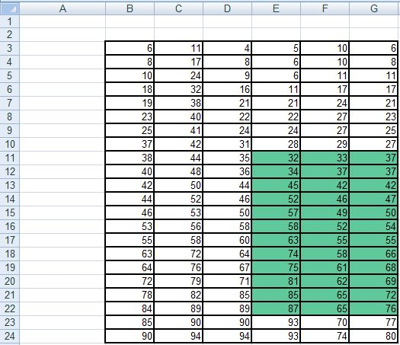
=VLOOKUP(IF(MIN(B6:F18)<>MAX(D3:G5), 38, 83), E11:G22,3)
=VLOOKUP(IF(11<>MAX(D3:G5), 38, 83), E11:G22,3)
=VLOOKUP(IF(11<>11), 38, 83), E11:G22,3)
=VLOOKUP(IF(FALSE, 38, 83), E11:G22,3)
=VLOOKUP(83, E11:G22,3)

Slide 65
(3) =VLOOKUP(MAX(B3:G4)*B6/G3, $C$8:$F$20, 3, FALSE)

Slide 66
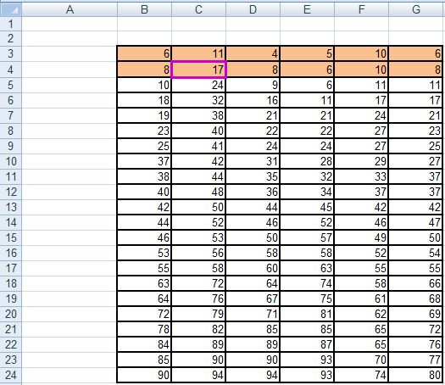
=VLOOKUP(MAX(B3:G4)*B6/G3, $C$8:$F$20, 3, FALSE)
=VLOOKUP(17*B6/G3, $C$8:$F$20, 3, FALSE)

Slide 67
=VLOOKUP(MAX(B3:G4)*B6/G3, $C$8:$F$20, 3, FALSE)
=VLOOKUP(17*B6/G3, $C$8:$F$20, 3, FALSE)
=VLOOKUP(17*18/G3, $C$8:$F$20, 3, FALSE)

Slide 68
=VLOOKUP(MAX(B3:G4)*B6/G3, $C$8:$F$20, 3, FALSE)
=VLOOKUP(17*B6/G3, $C$8:$F$20, 3, FALSE)
=VLOOKUP(17*18/G3, $C$8:$F$20, 3, FALSE)
=VLOOKUP(306/G3, $C$8:$F$20, 3, FALSE)

Slide 69
=VLOOKUP(MAX(B3:G4)*B6/G3, $C$8:$F$20, 3, FALSE)
=VLOOKUP(17*B6/G3, $C$8:$F$20, 3, FALSE)
=VLOOKUP(17*18/G3, $C$8:$F$20, 3, FALSE)
=VLOOKUP(306/G3, $C$8:$F$20, 3, FALSE)
=VLOOKUP(306/6, $C$8:$F$20, 3, FALSE)

Slide 70
=VLOOKUP(MAX(B3:G4)*B6/G3, $C$8:$F$20, 3, FALSE)
=VLOOKUP(17*B6/G3, $C$8:$F$20, 3, FALSE)
=VLOOKUP(17*18/G3, $C$8:$F$20, 3, FALSE)
=VLOOKUP(306/6, $C$8:$F$20, 3, FALSE)
=VLOOKUP(51, $C$8:$F$20, 3, FALSE)

Slide 71
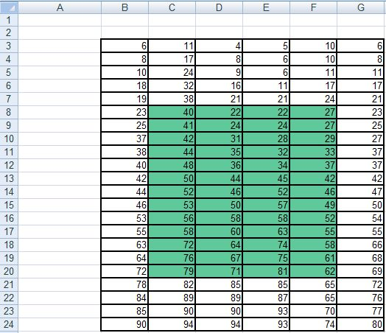
#N/A
=VLOOKUP(MAX(B3:G4)*B6/G3, $C$8:$F$20, 3, FALSE)
=VLOOKUP(17*B6/G3, $C$8:$F$20, 3, FALSE)
=VLOOKUP(17*18/G3, $C$8:$F$20, 3, FALSE)
=VLOOKUP(306/6, $C$8:$F$20, 3, FALSE)
=VLOOKUP(51, $C$8:$F$20, 3, FALSE)

Slide 72
(4) =VLOOKUP(C3*E3, C8:F20, IF(SUM(B3:B24)>SUM(F3:F24), 2, 4))

Slide 73
=VLOOKUP(C3*E3, C8:F20, IF(SUM(B3:B24)>SUM(F3:F24), 2, 4))
=VLOOKUP(11*E3, C8:F20, IF(SUM(B3:B24)>SUM(F3:F24), 2, 4))

Slide 74
=VLOOKUP(C3*E3, C8:F20, IF(SUM(B3:B24)>SUM(F3:F24), 2, 4))
=VLOOKUP(11*E3, C8:F20, IF(SUM(B3:B24)>SUM(F3:F24), 2, 4))
=VLOOKUP(11*5, C8:F20, IF(SUM(B3:B24)>SUM(F3:F24), 2, 4))

Slide 75
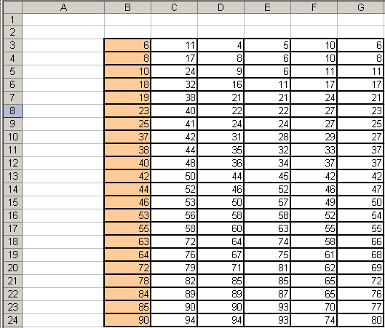
=VLOOKUP(C3*E3, C8:F20, IF(SUM(B3:B24)>SUM(F3:F24), 2, 4))
=VLOOKUP(11*E3, C8:F20, IF(SUM(B3:B24)>SUM(F3:F24), 2, 4))
=VLOOKUP(11*5, C8:F20, IF(SUM(B3:B24)>SUM(F3:F24), 2, 4))
=VLOOKUP(55, C8:F20, IF(1000>SUM(F3:F24), 2, 4))

Slide 76
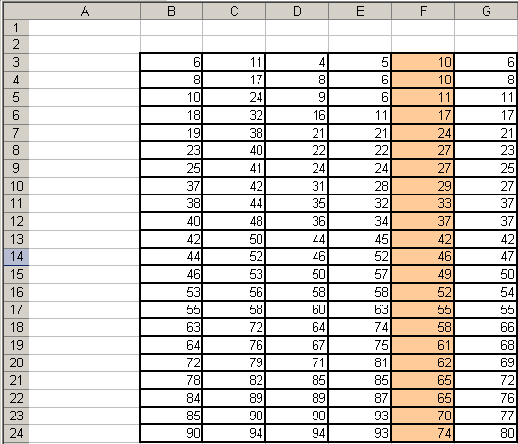
=VLOOKUP(C3*E3, C8:F20, IF(SUM(B3:B24)>SUM(F3:F24), 2, 4))
=VLOOKUP(11*E3, C8:F20, IF(SUM(B3:B24)>SUM(F3:F24), 2, 4))
=VLOOKUP(11*5, C8:F20, IF(SUM(B3:B24)>SUM(F3:F24), 2, 4))
=VLOOKUP(55, C8:F20, IF(1000>SUM(F3:F24), 2, 4))
=VLOOKUP(55, C8:F20, IF(1000>924, 2, 4))

Slide 77
=VLOOKUP(C3*E3, C8:F20, IF(SUM(B3:B24)>SUM(F3:F24), 2, 4))
…
=VLOOKUP(55, C8:F20, IF(1000>924, 2, 4))
=VLOOKUP(55, C8:F20, IF(TRUE, 2, 4))
=VLOOKUP(55, C8:F20, 2)

Slide 78
=VLOOKUP(C3*E3, C8:F20, IF(SUM(B3:B24)>SUM(F3:F24), 2, 4))
…
=VLOOKUP(55, C8:F20, 2)

Slide 79
=VLOOKUP(LARGE(D10:G17,4), $C$8:$F$20, 5, FALSE)

Slide 80
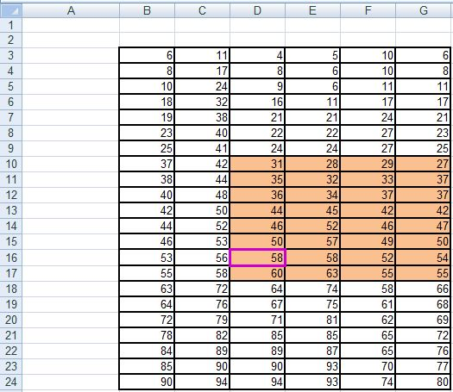
=VLOOKUP(LARGE(D10:G17,4), $C$8:$F$20, 5, FALSE)
=VLOOKUP(58, $C$8:$F$20, 5, FALSE)

Slide 81

#REF!
=VLOOKUP(LARGE(D10:G17,4), $C$8:$F$20, 5, FALSE)
=VLOOKUP(58, $C$8:$F$20, 5, FALSE)

Slide 82
Textbook Question
____, used to accumulate data about costs involved in producing specific products, make excellent use of IT to compile pricing data.
ERP Systems
Cost-accounting Systems
Human Resources Systems
SCM Systems

Slide 83
Textbook Question
____, used to accumulate data about costs involved in producing specific products, make excellent use of IT to compile pricing data.
ERP Systems
Cost-accounting Systems ✓
Human Resources Systems
SCM Systems
Ref: p.81

Slide 84
Textbook Question
When a pattern of defects is discovered in a product, ____________________ helps pinpoint the plant at which it was produced and the particular lot from which it came.

Slide 85
Textbook Question
When a pattern of defects is discovered in a product, ______R F I D_______ helps pinpoint the plant at which it was produced and the particular lot from which it came.
Ref: p.91

Slide 86
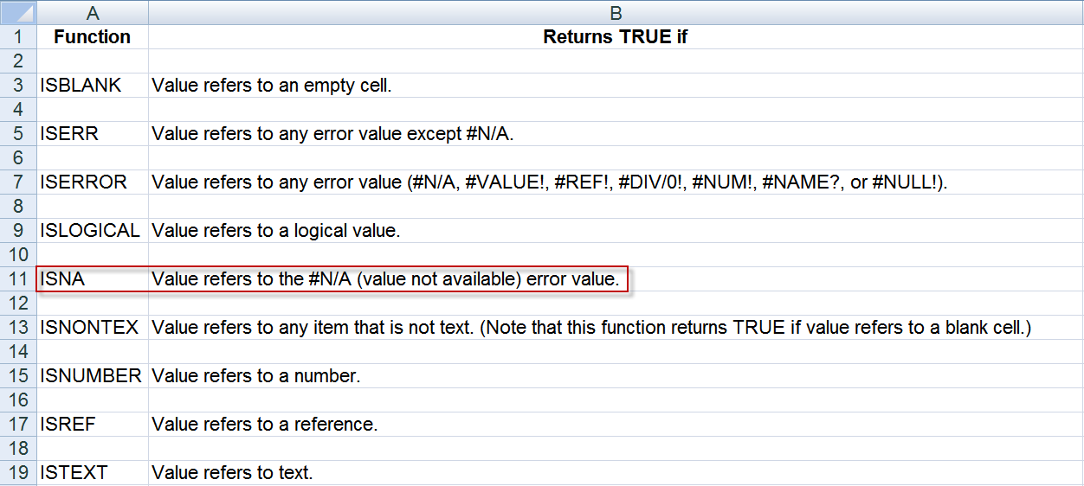
The IS functions

Slide 87
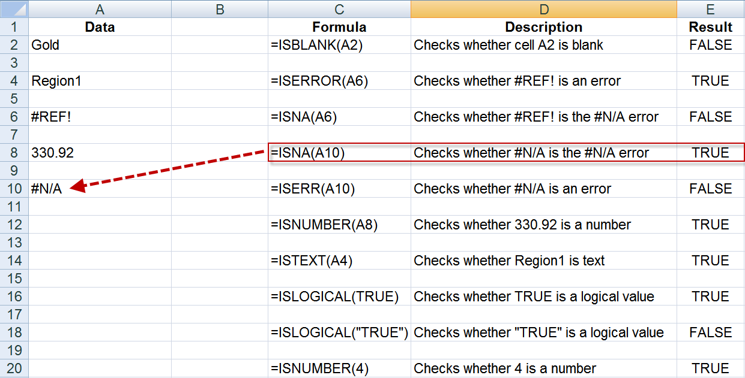
The ISNA function

